Slide 1
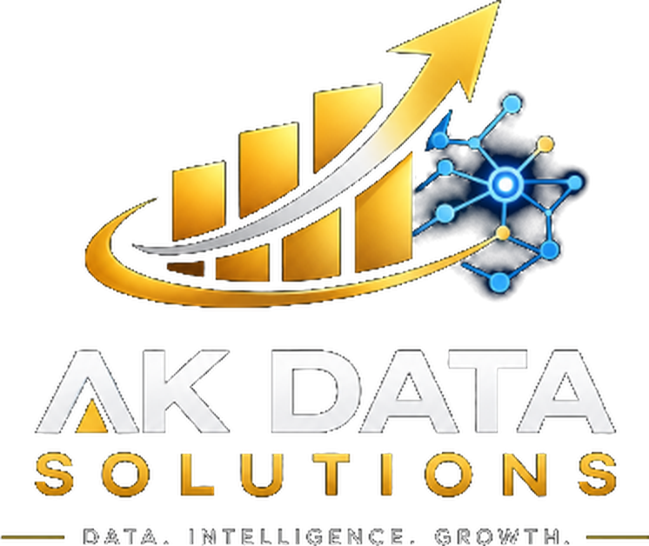
AI Training: sample slides
One sample from each AK Data Solutions program
Hands-on, practical and built around your own tools
akdatasolutions.com

Slide 2
Five programs, one for every part of your team
1
2
3
4
5
LEADERS
ALL STAFF
ANALYSTS
BUILDERS
YOUR AI
Executive AI briefing
Generative AI at work
AI for data and BI teams
Building AI agents
Custom AI model training
What AI can and can't do, risks and a roadmap
Use AI assistants safely for everyday work
Power BI, SQL, Python and Excel with AI
Search, RAG and agents connected to your data
Teach AI your terms, documents and style
Half day
2–3 hours
1–2 days
2–3 days
Project

Slide 3
What AI can and can't do for your organization today
Leaders · Executive AI briefing
AI can
AI can't (yet)
Draft emails, reports and summaries in seconds
Answer questions from your own documents, with sources
Spot trends in data and write the first version of a report
Automate repetitive steps between systems
Make final decisions or take responsibility
Be trusted without checking facts and numbers
Know your private data unless you connect it securely
Replace domain experts and good data
Takeaway: start with low-risk, high-volume tasks, and keep a person in the loop.

Slide 4
A good prompt has four parts
All staff · Generative AI at work
Role
Who should the AI act as?
Example prompt
You are a nonprofit communications writer.
Write a thank-you email to a first-time donor.
They gave $100 to our Fall Community Walk.
Under 120 words, warm tone, one call to action.
Task
What exactly do you want?
Context
What does it need to know?
Format
How should the answer look?
Exercise: rewrite one email you sent this week using all four parts.

Slide 5
Safe AI use: five rules for every staff member
All staff · Generative AI at work
Protect private data
Never paste donor, client or employee details into public AI tools.
Be open about AI
Tell readers when AI helped write something that matters.
1
4
Check the facts
AI can sound confident and still be wrong. Verify names, numbers and dates.
Keep a human in charge
You own the final result, not the AI.
2
5
Use approved tools
Stick to the AI tools your organization has approved and configured.
Print this slide as a desk card for your team.
3

Slide 6
Let AI write the first draft of your DAX, then check it
Analysts · AI for data and BI teams
You ask
“Write a Power BI measure for donations this year compared with the same period last year, as a percent.”
You check
✓
Does the date table cover every day?
Time intelligence needs a complete, marked date table.
✓
Do the numbers match a known total?
Compare one month against your finance report.
AI drafts
YoY % =
VAR ThisYear = [Total Donations]
VAR LastYear =
CALCULATE([Total Donations],
SAMEPERIODLASTYEAR('Date'[Date]))
RETURN DIVIDE(ThisYear - LastYear, LastYear)
✓
What happens with blanks or zero?
DIVIDE avoids errors when last year is empty.
✓
Is it readable for the next person?
Ask AI to add comments, then keep them.

Slide 7
How a research agent answers a question
Builders · Building AI agents
1. Question
2. Search
3. Read
4. Answer
5. Cite
“What did our 2019 study find about water quality?”
›
Finds the most relevant pages in your document database
›
Pulls the exact passages and page numbers
›
Writes a short answer from those passages only
›
Shows the sources so people can check
Hands-on lab: build this agent on 50 of your own PDFs, then test it with questions your team really asks.

Slide 8
Teach AI your organization's language, then prove it works
Your AI · Custom AI model training
Collect
Glossary, past reports, style guide and 100+ real questions with good answers
1
Teach
Ground the AI in your documents and tune it on your terms and tone
2
Test
Score answers against your question set before anyone relies on it
3
Numbers are illustrative; we measure your real results during the project.

Slide 9
Train your team with AK Data Solutions
On-site in Northern Virginia or live online, with materials and exercises built on your own tools.
Book a free consultation with Amir at akdatasolutions.com

