Slide 1

Sample Donor Dashboard
A Power BI-style reporting sample for a nonprofit
Data through Sep 30, 2026 · Fictional data
akdatasolutions.com
Notes:
Fictional sample dashboard by AK Data Solutions. No real donors or organizations.

Slide 2
2026 at a glance: giving is up 24% on last year
$1.68M
1,885
56%
$459
raised in 2026 YTD
donors gave in 2026
donor retention
average gift
+23.9% vs 2025 YTD
+22.4% vs 2025 YTD
2025 donors who gave again
+4.7% vs 2025 YTD
What leaders see first
Major gifts bring in $1.1M of $1.68M.
The Capital Campaign is 71% to goal with 3 months left.
Fall Community Walk is at risk (39% of goal).

Slide 3
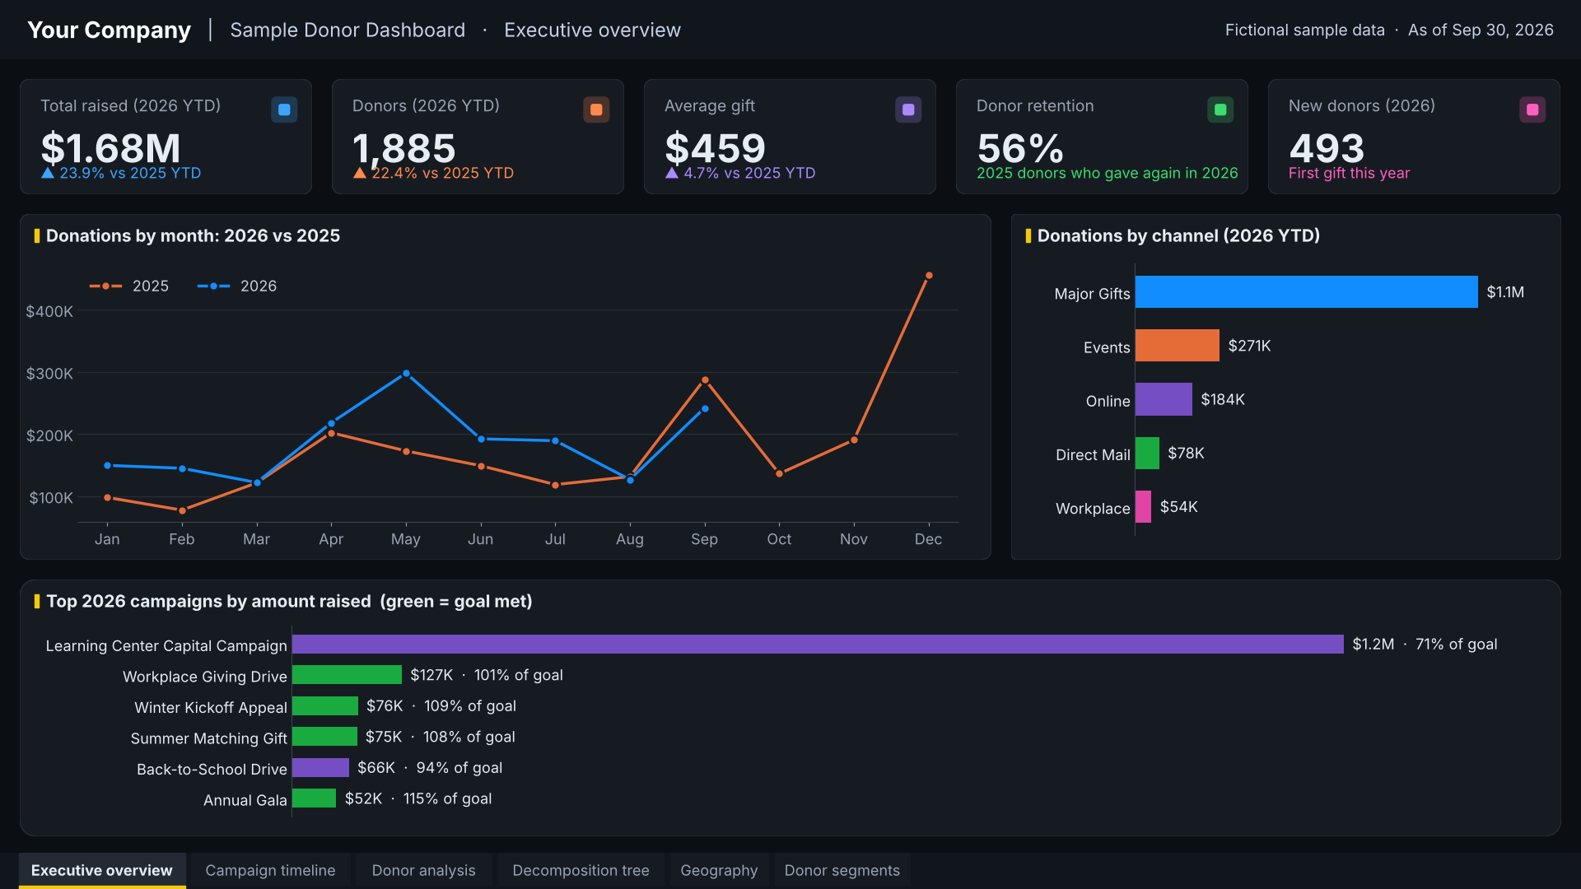
1. Executive overview
KPIs, monthly trend and top campaigns on one page
5 headline KPIs with change vs last year
Monthly giving: 2026 vs 2025
Top campaigns with % of goal
Notes:
Executive overview: KPIs, monthly trend and top campaigns on one page. Built from fictional sample data (gifts, donors, campaigns).

Slide 4
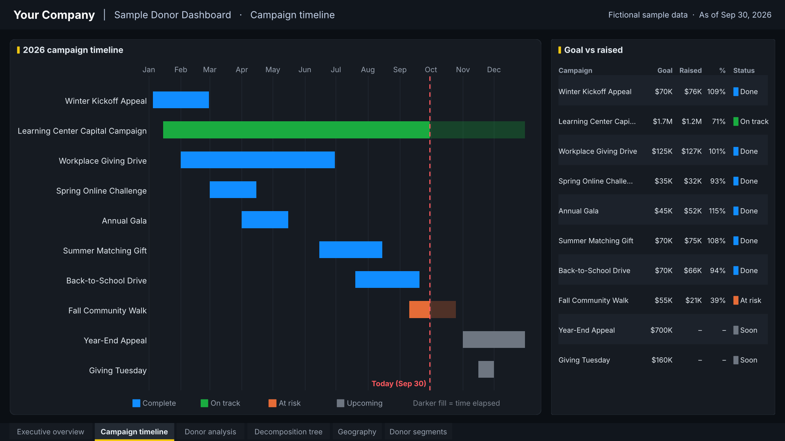
2. Campaign timeline (Gantt chart)
Every 2026 campaign on one timeline, colored by status
Today line shows what is still running
Status: complete, on track, at risk, upcoming
Goal vs raised table beside the timeline
Notes:
Campaign timeline (Gantt chart): Every 2026 campaign on one timeline, colored by status. Built from fictional sample data (gifts, donors, campaigns).

Slide 5
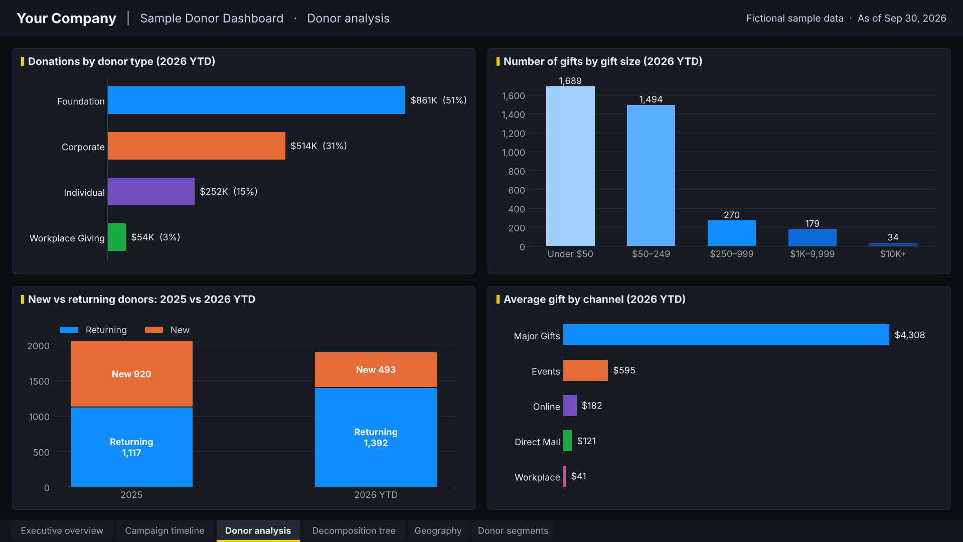
3. Donor analysis
Who gives, how much, and through which channel
Donations by donor type
Gift-size bands
New vs returning donors
Average gift by channel
Notes:
Donor analysis: Who gives, how much, and through which channel. Built from fictional sample data (gifts, donors, campaigns).

Slide 6
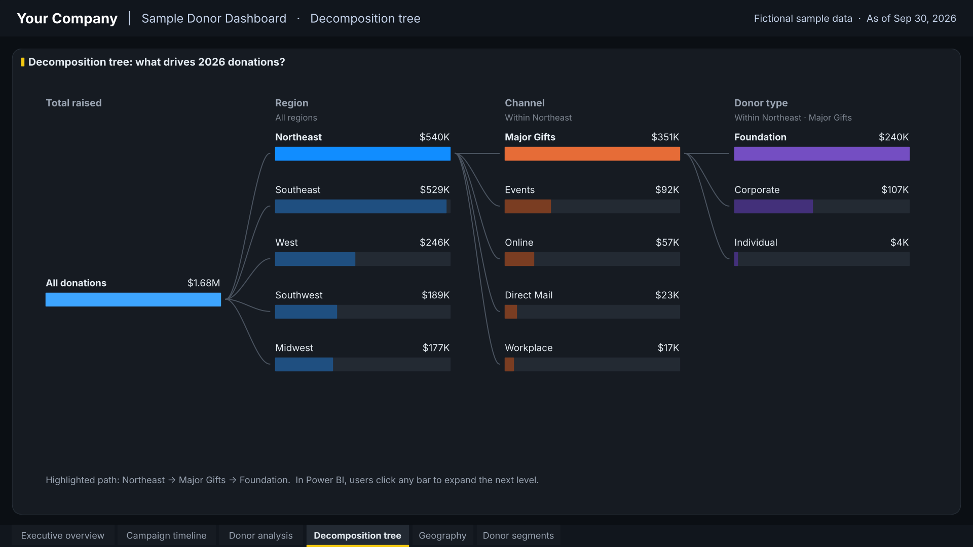
4. Decomposition tree
Drill from the total into what drives it
Total → region → channel → donor type
Northeast leads, driven by major gifts
In Power BI, click any bar to expand
Notes:
Decomposition tree: Drill from the total into what drives it. Built from fictional sample data (gifts, donors, campaigns).

Slide 7
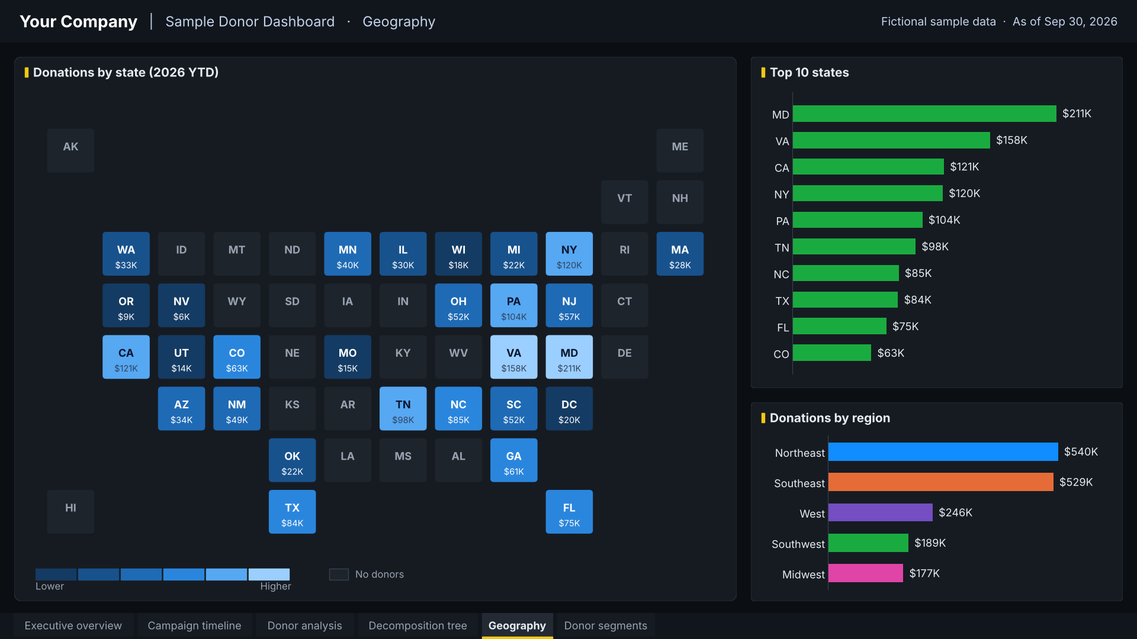
5. Geography
Where donations come from
State tile map, darker = more giving
Top 10 states
Totals by region
Notes:
Geography: Where donations come from. Built from fictional sample data (gifts, donors, campaigns).

Slide 8
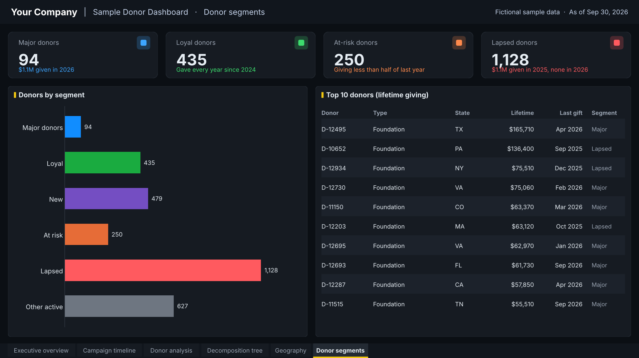
6. Donor segments
Who to thank, who to win back
Major, loyal, new, at-risk and lapsed
250 at-risk and 1,128 lapsed donors to re-engage
Top 10 donors by lifetime giving
Notes:
Donor segments: Who to thank, who to win back. Built from fictional sample data (gifts, donors, campaigns).

Slide 9
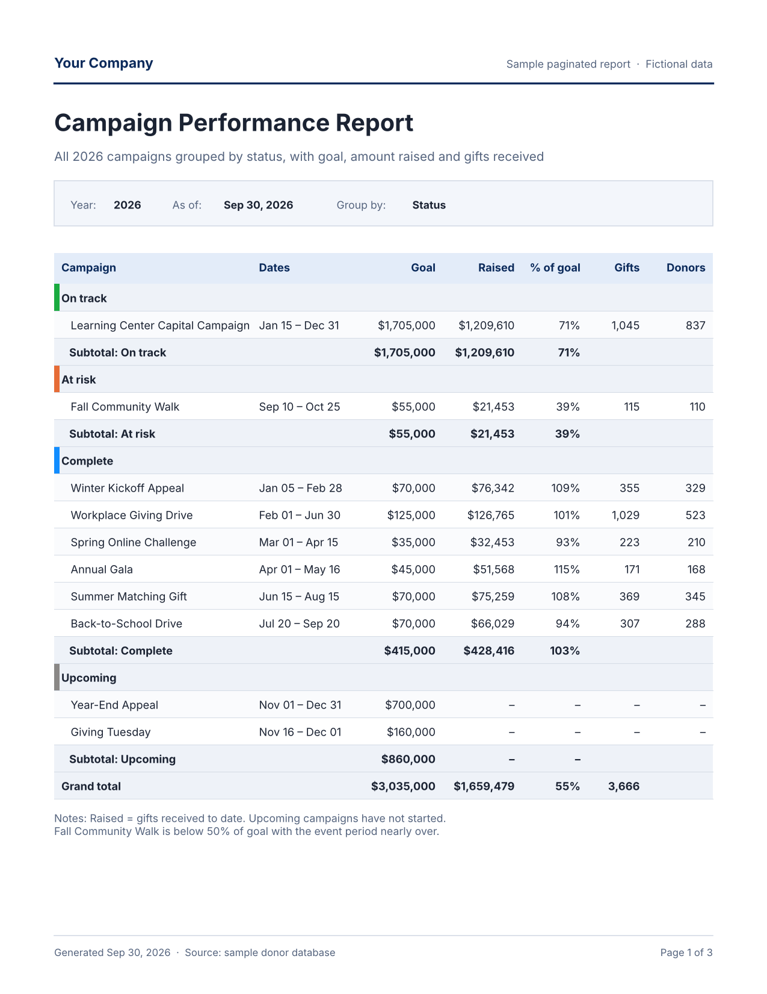
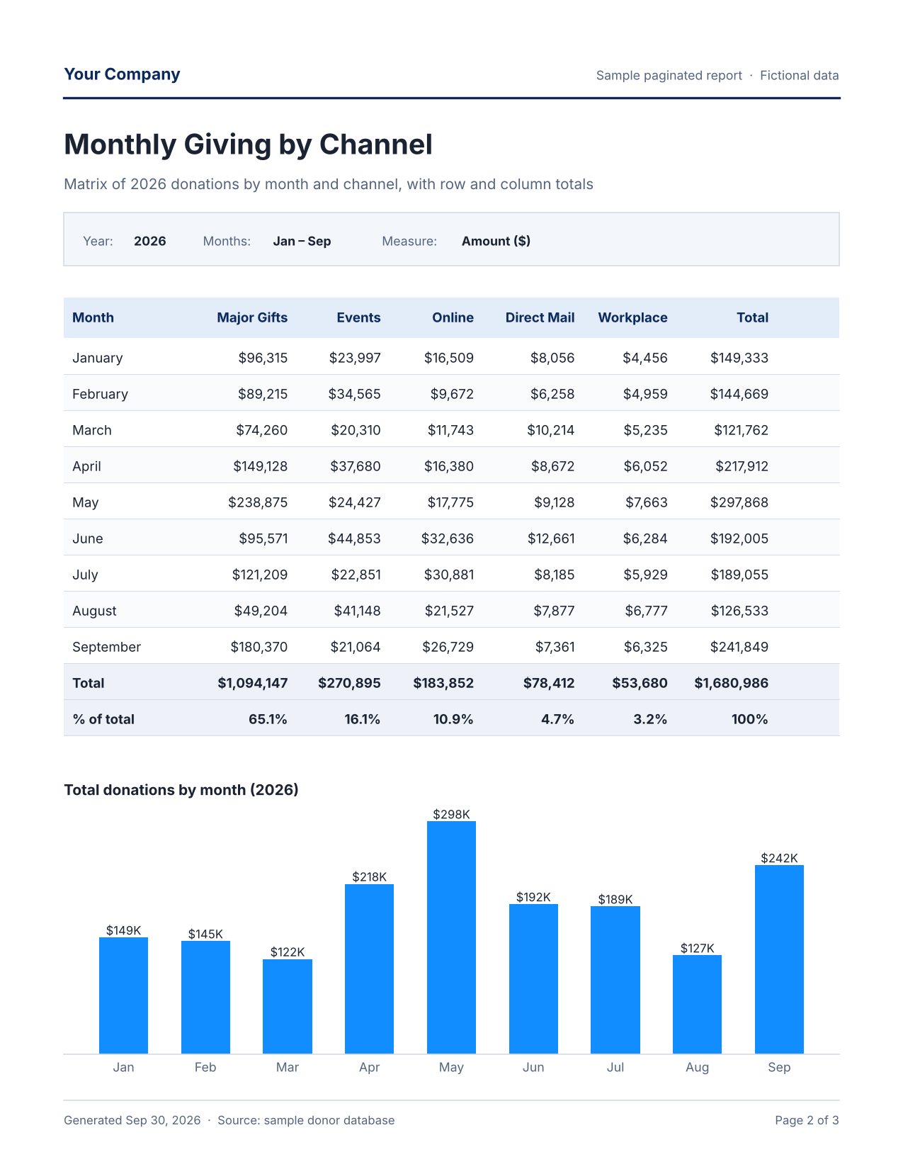
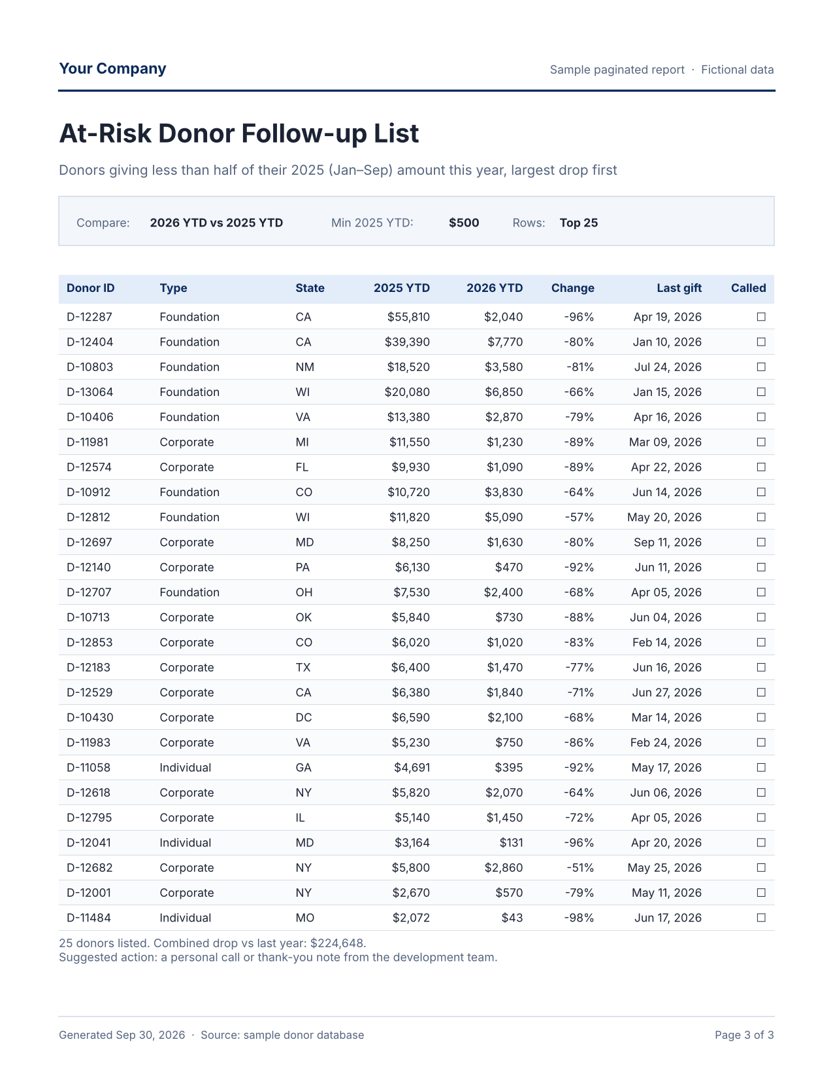
Paginated reports: print-ready, scheduled, emailed
Built to your needs
Board packets, finance and staff reports, delivered as PDF or Excel on a schedule.
Campaign Performance Report
Monthly Giving by Channel
At-Risk Donor Follow-up List
Campaigns grouped by status, with subtotals and a grand total
Month-by-channel matrix with row and column totals
Printable call list of donors whose giving dropped
Notes:
Paginated reports are built with Power BI Report Builder. The full sample reports are in AK-Sample-Paginated-Reports.pdf.

Slide 10
Want this for your data?
AK Data Solutions builds Power BI dashboards and reports based on your requirements.
Book a free consultation with Amir at akdatasolutions.com

